Slide 1
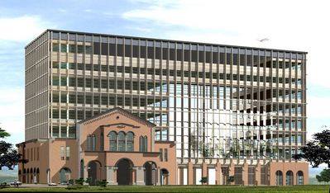
Biological Sequence Comparison and Alignment
Speaker: Yu-Hsiang Wang
Advisor: Prof. Jian-Jung Ding
Digital Image and Signal Processing Lab
Graduate Institute of Communication Engineering
National Taiwan University

Slide 2
Outline
Introduction of biological sequence alignment
Sequence alignment algorithm
Dynamic programming
FASTA & BLAST
UDCR
Less-redundant fast algorithm
Algorithm for approximate string matching and improvement
Conclusion
Reference

Slide 3
Introduction of biological sequence alignment
Two strings: S₁: “caccba” and S₂: “cabbab”
Alignment:
where

Slide 4
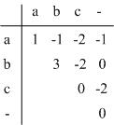
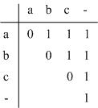
Introduction of biological sequence alignment
The edit distance between two strings
Scoring matrix of alphabet
or
Similarity

Slide 5
Dynamic programming
The fundamental sequence alignment algorithm
The recurrence relation
Tabular computation
The traceback

Slide 6
Dynamic programming
The recurrence relation:
Define D(i, j) to be the edit distance of S₁[1..i] and S₂[1..j]
Base condition:
D(i, 0)=i (the first column)
D(0, j)=j (the first row)
Recurrence relation:
D(i, j) = min[D(i-1, j) + d, D(i, j-1) + d, D(i-1, j-1) + t(i, j)]
where t(i, j)=e if S₁(i)=S₂(j); otherwise t(i, j)=r
(Assume d=1, r=1, and e=0)

Slide 7
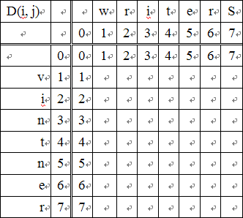
Dynamic programming
Tabular computation
Initial table

Slide 8
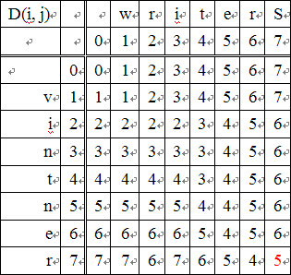
Dynamic programming
Tabular computation
Finished table

Slide 9
Dynamic programming
The traceback
If D(i, j)=D(i, j-1)+1, set a pointer from (i, j) to (i, j-1), denote as “←”
If D(i, j)=D(i-1, j)+1, set a pointer from (i, j) to (i-1, j), denote as “↑”
If D(i, j)=D(i-1, j-1)+t(i, j)，set a pointer from (i, j) to (i-1, j-1) as “↖”
where t(i, j)=0 if S₁(i)=S₂(j); otherwise t(i, j)=1

Slide 10
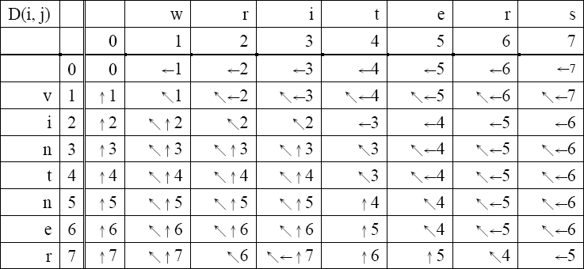
Dynamic programming
The traceback

Slide 11
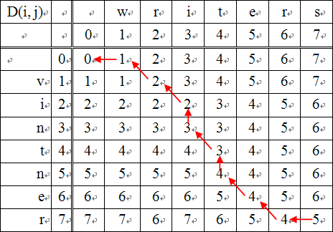
Dynamic programming
Alignment(1)
S₁:wri-t-ers
S₂:-vintner-

Slide 12
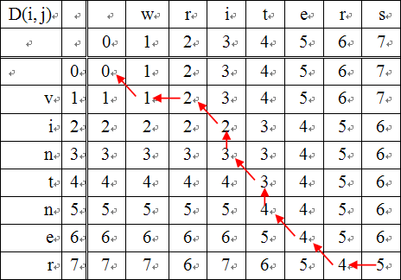
Dynamic programming
Alignment(2)
S₁:wri-t-ers
S₂:v-intner-

Slide 13
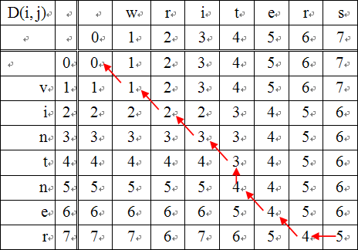
Dynamic programming
Alignment(3)
S₁:wri-t-ers
S₂:vintner-

Slide 14
FASTA
The main idea: similar sequences probably share some short matches (word)
Only search for the consecutive identities of length k (k-tuple word)

Slide 15
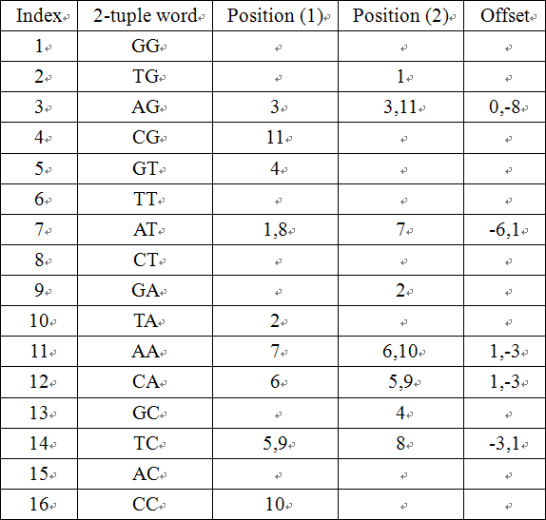
FASTA
Step1:Select k to establish the lookup table
“ATAGTCAATCCG” and “TGAGCAATCAAG”

Slide 16
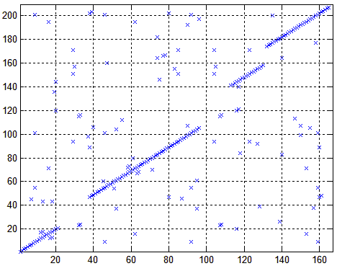
FASTA
Step2: labels each k-tuple word as an “x”
(the word hits sharing same offset are on a same diagonal)

Slide 17
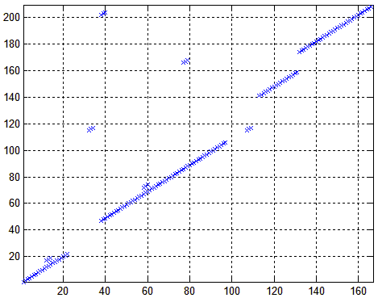
FASTA
Step3: Choose 10 best diagonal regions

Slide 18
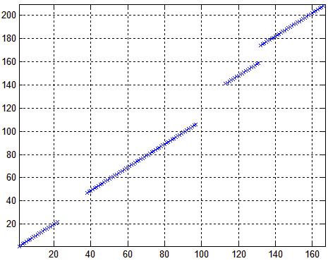
FASTA
Step4: If a region’s score is higher than the threshold, it can remain

Slide 19
FASTA
Step5: Combine these remained regions into a longer high-scoring alignment (allow some spaces)

Slide 20
BLAST
Similar to FASTA
BLAST only care about the high-scoring words
Establish a list to store those words

Slide 21
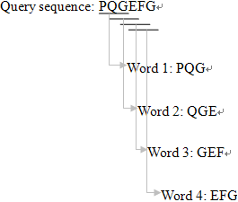
BLAST
For example (3-mers):
15
PEG
12
PQA

Slide 22
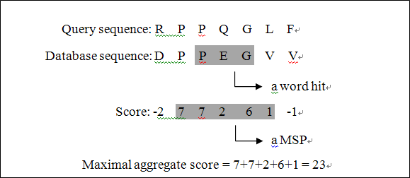
BLAST
For example, set D-score as 0

Slide 23
UDCR
Use unitary mapping to represent the four types of nucleotide
b_{x}[τ] = 1 if x[τ] = ‘A’,
b_{x}[τ] = -1 if x[τ] = ‘T’,
b_{x}[τ] = j if x[τ] = ‘G’,
b_{x}[τ] = -j if x[τ] = ‘C’

Slide 24
UDCR
Calculate discrete correlations:
For example
x = ‘GTAGCTGAACTGAAC’;
y = ‘AACTGAA’,
b_{x} = [j, −1, 1, j, −j, −1, j, 1, 1, −j, −1, j, 1, 1, −j],
b_{y} = [1, 1, −j, −1, j, 1, 1].
z₁= [j,-1+j, 1,1+j, -j,-1-j,-3+j2, j3,6+j,1-j4,-4-j3,
-4+j3,2+j5, 7,2-j5,-3-j3,-3+j2, 1+j3, 3, 1-j, -j],
z₂= [−1, 0, 3, −2, −1, 0, −1, 1, 5, −5, 1, 1, −3, 7, −3, 0, 1,
−2, 3, 0, −1]

Slide 25
UDCR
Similarity
since s[2]=6, we can know that the sequence {x[2],x[3],…,x[7]} is similar to y:
x =‘GTAGCTGAACTGAAC’, y = ‘AACTGAA’.

Slide 26
Less-redundant fast algorithm
The movement ↘ is generalized and the movement → is removed
New method to determine edit distance:
D(i, j)=min [D(i-1, j₀) + j - j₀ – 1 + s(i, j, j₀)]
where s(i, j, j) = 2,
s(i, j, j₀) = 1, if j₀≦j-1 and x(τ) ≠ y(j) for all τ in the range of j₀+1≦τ≦j
s(i, j, j₀) = 0, if j₀≦j-1 and x(τ) = y(j) for a τ in the range of j₀+1≦τ≦j

Slide 27
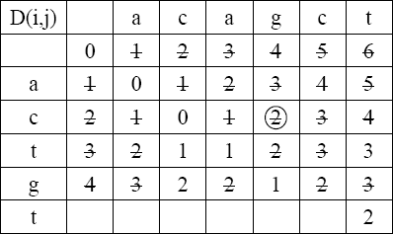
Less-redundant fast algorithm
Slope rule
If D(i, j_{a}) and D(i, j_{b}) on the same row satisfy
D(i, j_{b}) - D(i, j_{a}) ≧ | j_{b} - j_{a} |
then D(i, j_{b}) can be ignored.

Slide 28
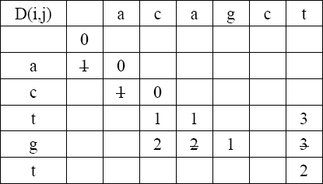
Less-redundant fast algorithm
Different entry rule(1)
If (a) x(i) ≠ y(j) (b) D(i-1, j) is inactive
(c) D(i-1. j-1) is active,
then D(i, j) can be calculated by
“D(i, j) = D(i-1, j-1) + 1”
inactive
active
inactive

Slide 29
Less-redundant fast algorithm
Different entry rule(2)
If (a) x(i) ≠ y(j) (b) D(i-1, j) is active
(c) x(i) ≠ y(j+1),
then D(i, j) can be calculated by
“D(i, j) = D(i-1, j) + 1”

Slide 30
Less-redundant fast algorithm
Different entry rule(3)
If (a) x(i) ≠ y(j) (b) D(i-1, j) is active
(c) x(i) = y(j+1),
then “D(i, j) can be ignored”

Slide 31
Less-redundant fast algorithm
Same entry rule(1)
If (a) x(i) = y(j) (b) D(i-1, j) is inactive
(c) one of D(i-1, j₁), D(i-1, j₁+1), …,D(i-1, j-1) is active,
then D(i, j) can be calculated by
“D(i, j) = D(i-1, j₂) + j - j₂ – 1”

Slide 32
Less-redundant fast algorithm
Same entry rule(2)
If (a) x(i) = y(j) (b) D(i-1, j) is active
(c) none of D(i-1, j₁),D(i-1, j₁+1),…,D(i-1, j-1) is active,
then D(i, j) can be calculated by
“D(i, j) = D(i-1, j₂) + 1” when x(i+1) ≠ y(j),
“D(i, j) can be ignored” when x(i+1) = y(j).

Slide 33
Less-redundant fast algorithm
Same entry rule(3)
If (a) x(i) = y(j) (b) D(i-1, j) is active
(c) one of D(i-1, j₁),D(i-1, j₁+1),…,D(i-1, j-1) is active,
then D(i, j) can be calculated by
“D(i, j) = D(i-1, j₂) + 1” when x(i+1) ≠ y(j),
“D(i, j) can be ignored” when x(i+1) = y(j).

Slide 34
Less-redundant fast algorithm
Limitation rule
First, Roughly estimate the upper bound of the edit distance H₁ by
where k(x(i), y(j))=0 if x(i) = y(j) and
k(x(i), y(j))=1 if x(i) ≠ y(j).

Slide 35
Less-redundant fast algorithm
Limitation rule
The diagram of H₁. (a) τ is 1. (b) No movement. (c) τ is -1.

Slide 36
Less-redundant fast algorithm
Limitation rule
Set the upper bound of the edit distance as
where Max(N-i, M-j) is the maximal possible edit distances between x[i…N] and y[j…M].

Slide 37
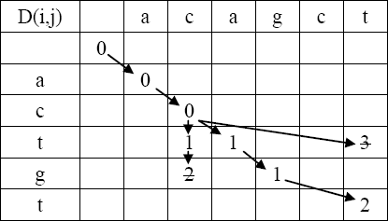
Less-redundant fast algorithm
Limitation rule
If
then D(i, j) can be ignored.

Slide 38
Algorithm for approximate string matching
Focus on diagonal.
Define f_{kp} = the largest index i
k denote the diagonal’s number
p denote the edit distance’s value

Slide 39
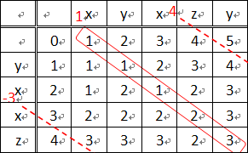
Algorithm for approximate string matching
f_{1,-1}=-∞, f_{1,0}=-1, f_{1,1}=2, f_{1,2}=3, f_{1,3}=4.
Computation range: -p ~ N-M+p

Slide 40
Improved algorithm for approximate string matching
Use main diagonal N-M to separate table.
Linking List
New scoring scheme

Slide 41
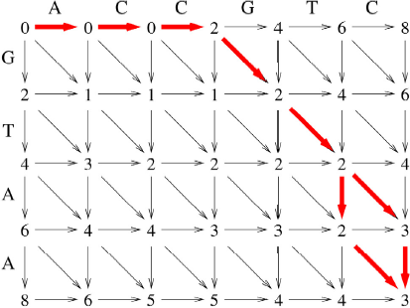
Improved algorithm for approximate string matching
Example of new scoring scheme

Slide 42
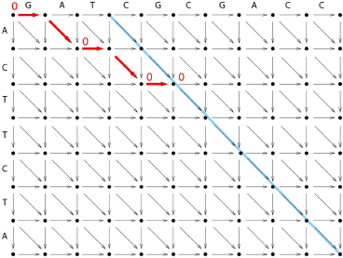
Improved algorithm for approximate string matching
Score 0 iteration

Slide 43
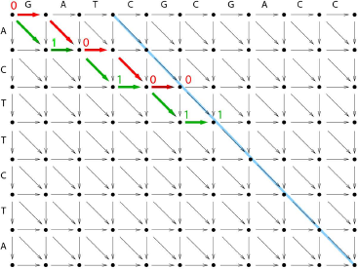
Improved algorithm for approximate string matching
Score 1 iteration

Slide 44
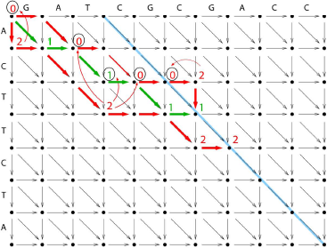
Improved algorithm for approximate string matching
Score 2 iteration

Slide 45
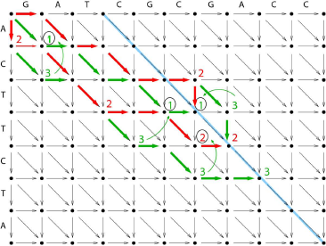
Improved algorithm for approximate string matching
Score 3 iteration

Slide 46
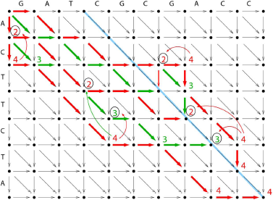
Improved algorithm for approximate string matching
Score 4 iteration
Edit distance: iteration+(N-M) = 4+(10-7) = 7

Slide 47
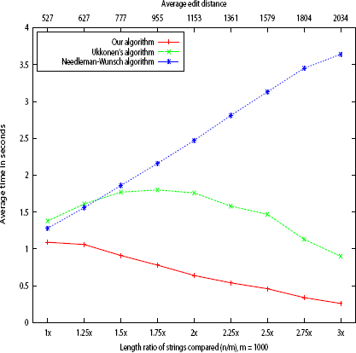
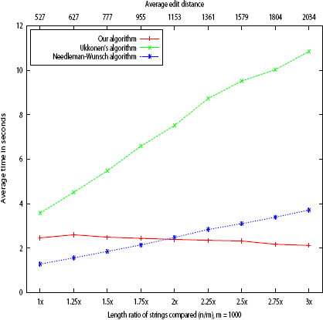
Improved algorithm for approximate string matching
Experiments (complexity depend on s-|M-N|)
Strings on 4-letters alphabet
Strings on 20-letters alphabet

Slide 48
Conclusion
Traditional Dynamic programming costs too much computational time and memory.
Less-redundant fast algorithm can save lots of time and space.
Improved algorithm for approximate string matching can also save lots of time and space. (Although it cannot traceback to get the alignment)

Slide 49
Reference
[1] D. Gusfield, Algorithms on Strings, Trees, and Sequence, Cambridge University Press, 1997.
[2] S. C. Pei, J. J. Ding “Sequence Comparison and Alignment by Discrete Correlations, Unitary Mapping, and Number Theoretic Transforms”
[3] K.H. Hsu, “Faster Algorithms for Computing Edit Distance and Alignment between DNA Strings”, 2009.
[4] J. J. Ding, K. H. Hsu, “A Less-Redundant Fast Algorithm for Computing Edit Distances Exactly”
[5] E. UKKONEN, “Algorithms for Approximate String Matching,” Information and Control 64, 100-118, 1985
[6] D. Papamichail and G. Papamichail, “Improved Algorithms for Approximate String Matching,” BMC Bioinformatics, Vol.10(Suppl.1):S10, January, 2009

